Slide 1


The Fediverse Six Months From Now
Stephen Downes
Reclaim Open Conference
November 5, 2025

Slide 2
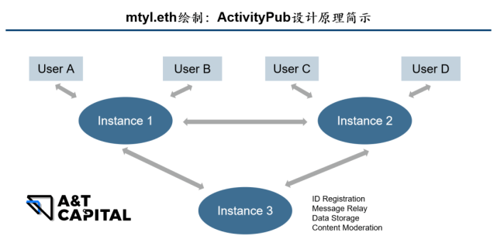
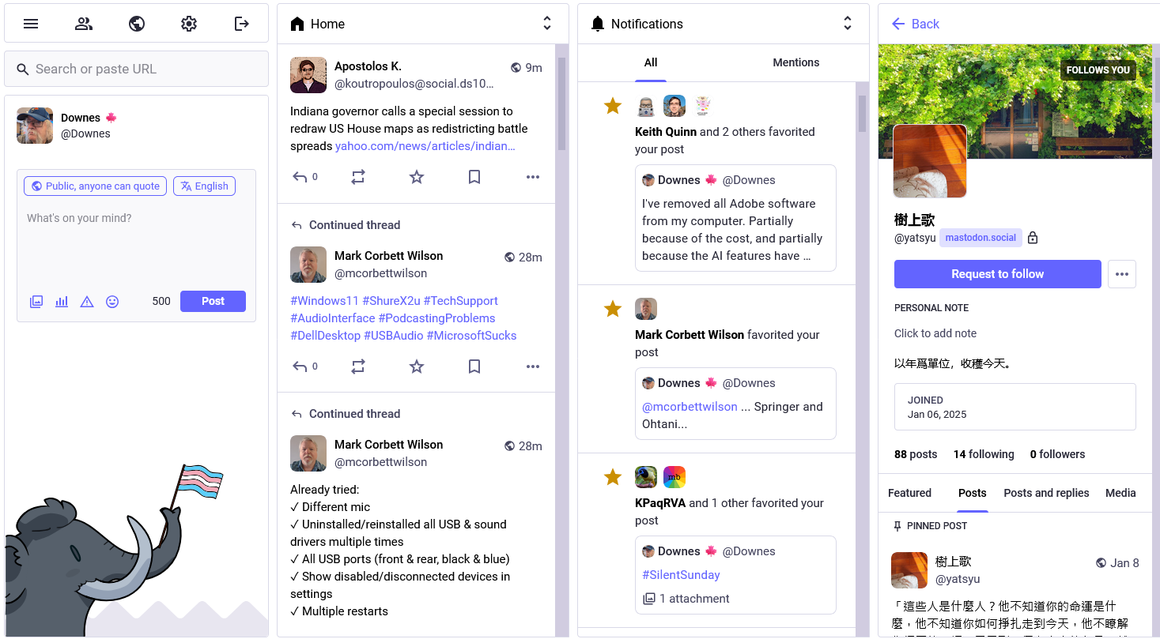
What is the Fediverse?
Multiple servers (aka ‘instances’) instead of a single server
Interactions between users on different servers

Slide 3
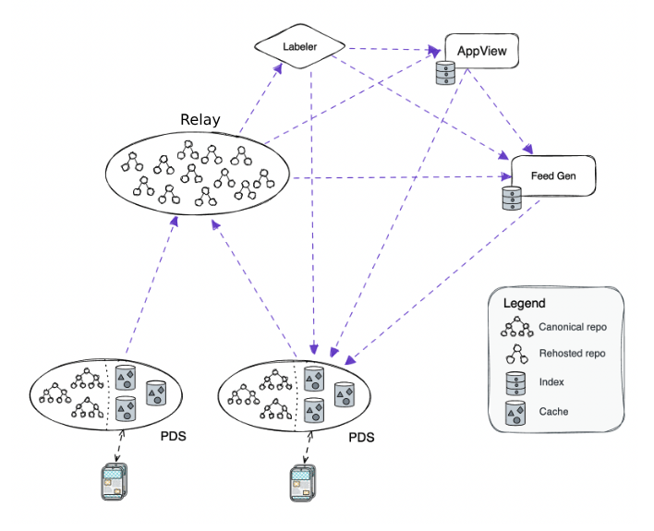
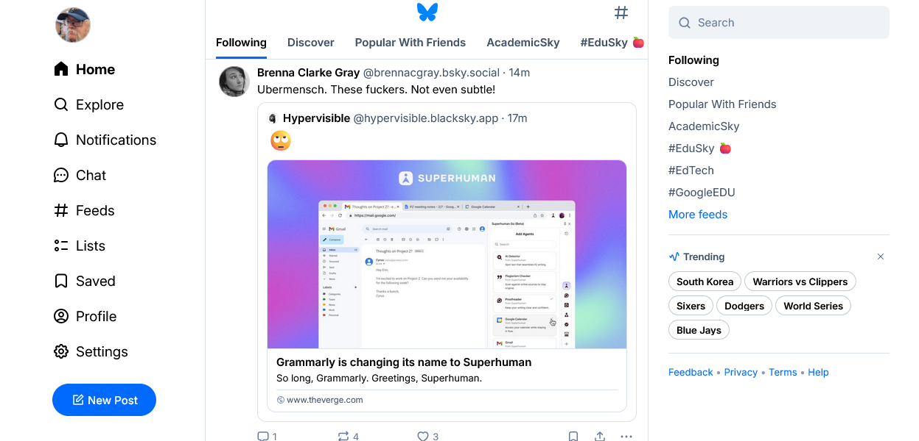
ActivityPub vs Atmosphere
Multiple personal data servers (PDS)
Relay aggregates (new) content from PDSs
App provides a ‘view’ from the Relay data

Slide 4
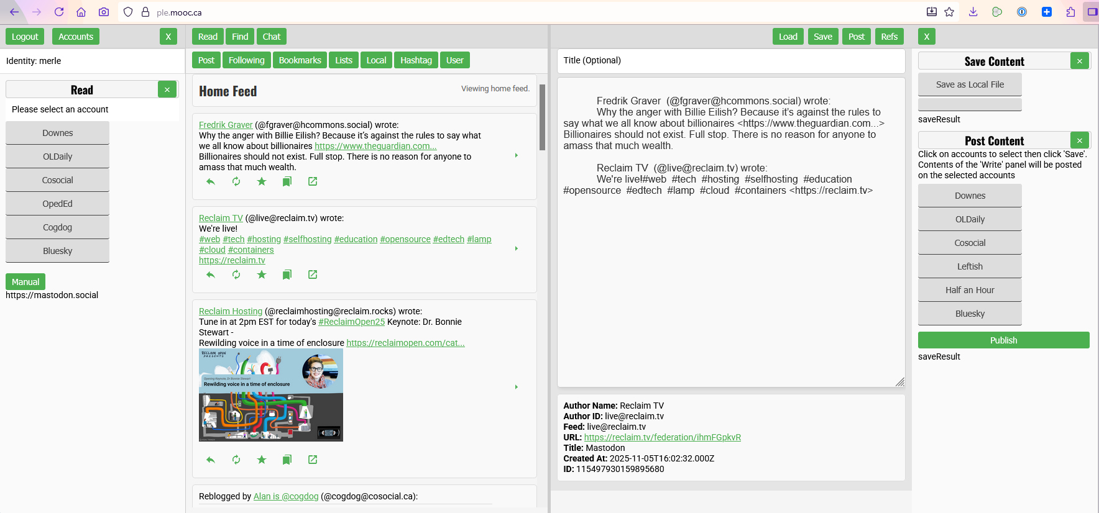
Where I’m Coming From
https://ple.mooc.ca https://www.downes.ca/presentation/594

Slide 5
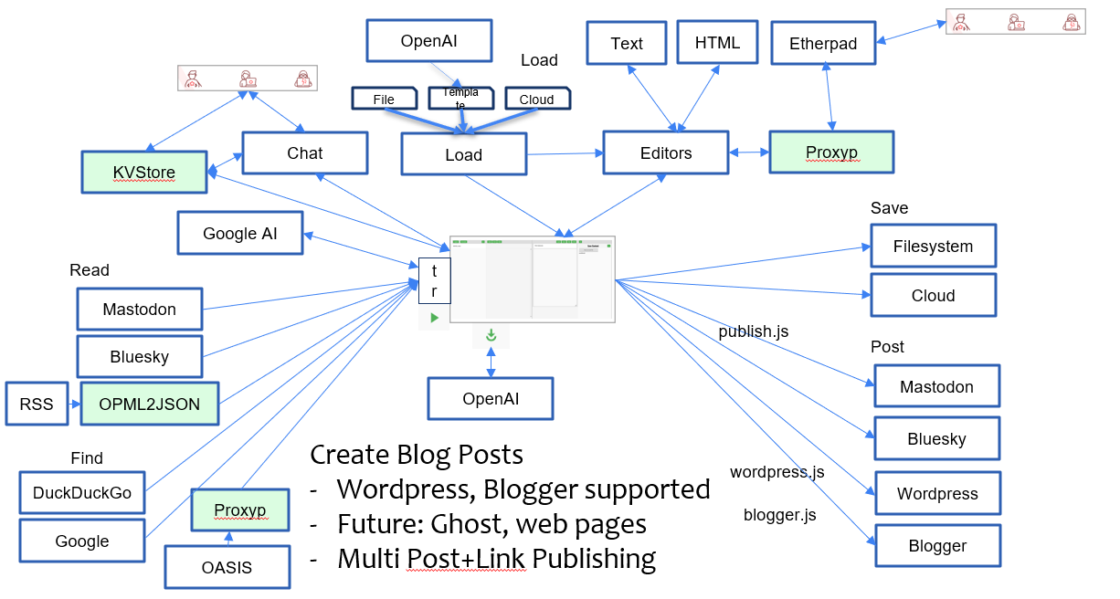
Where I’m Coming From

Slide 6
Where I’m Coming From

Slide 7
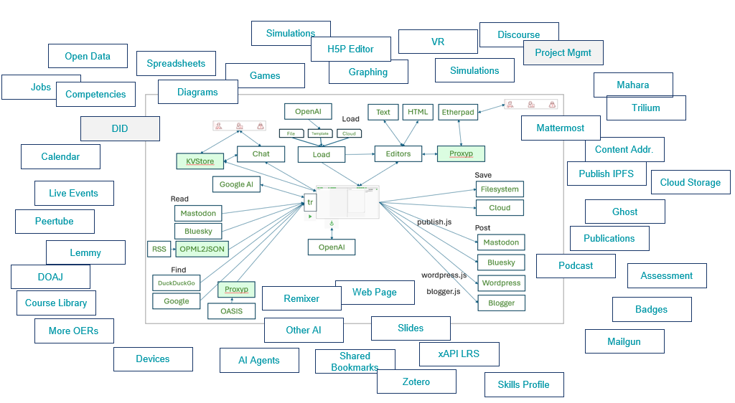
The Future

Slide 8
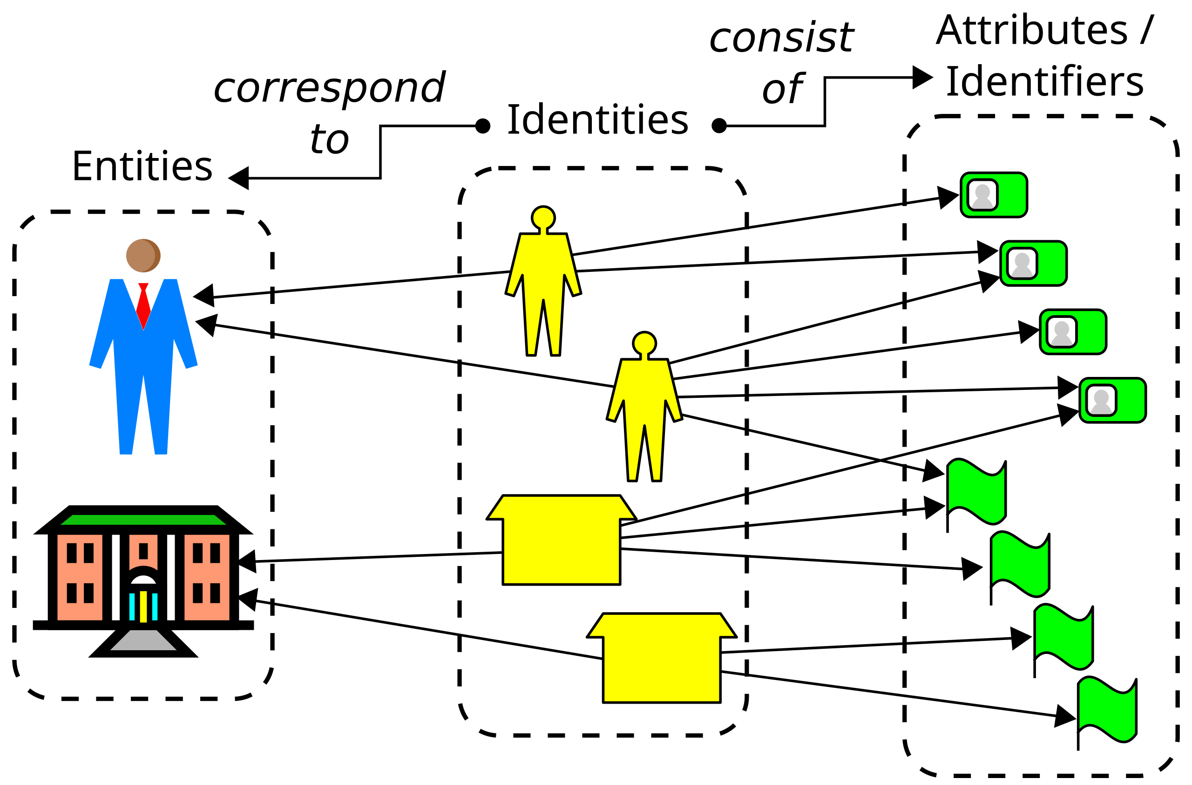
Design Considerations
Issues related to decentralized identity
OAuth2 https://auth0.com/intro-to-iam/what-is-oauth-2
OIDC https://openid.net/developers/how-connect-works/
Self-Sovereign Identity https://en.wikipedia.org/wiki/Self-sovereign_identity
Key-Value Stores
Cloud, e.g. Vault
Host, e.g. 1Password
Dock. Decentralized Identity: The Ultimate Guide. https://www.dock.io/post/decentralized-identity

Slide 9
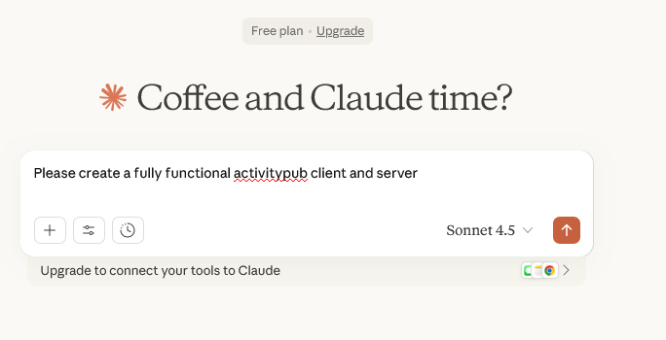
The Real Future

Slide 10
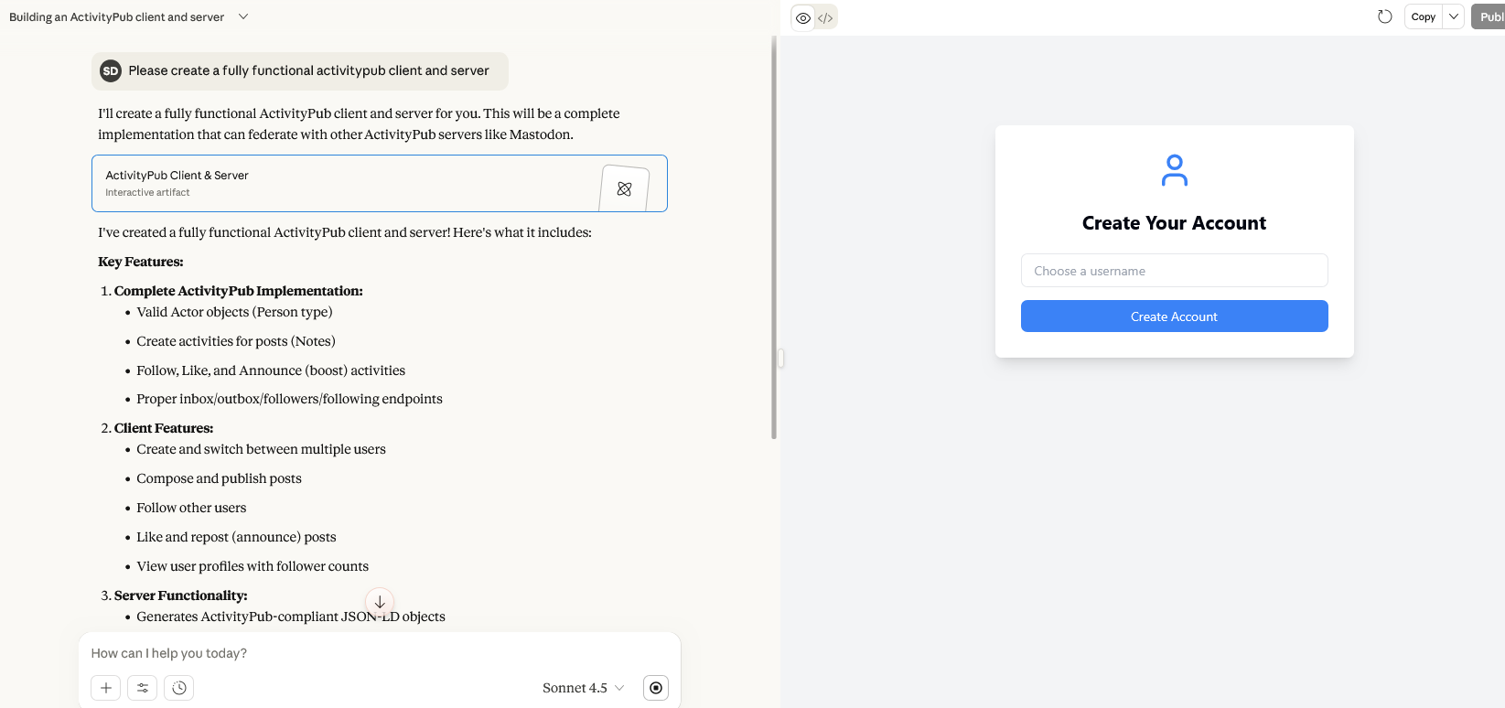
The Real Future

Slide 11
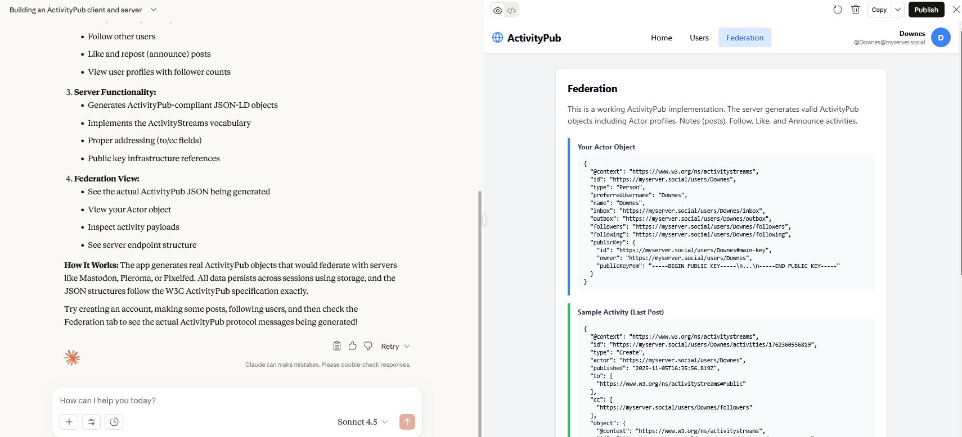
The Real Future

Slide 12
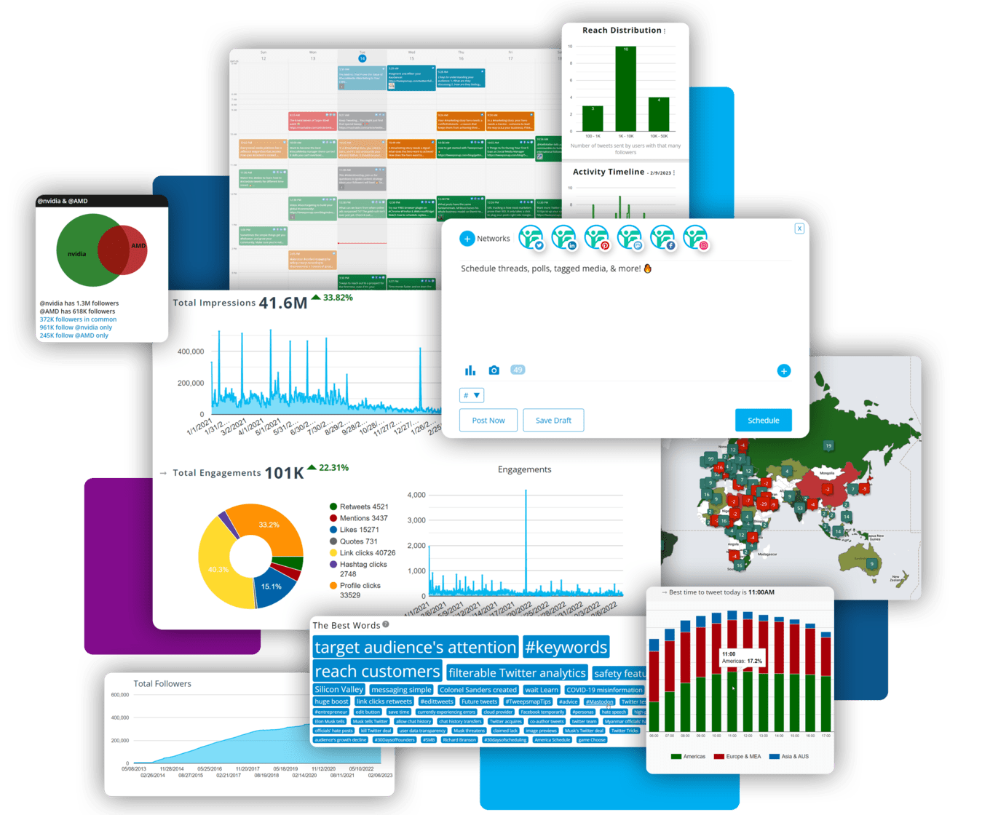
The Sort of Services Leading to This
ActivityPub Fuzzer – emulates different dialects that are used in ActivityPub https://asml.cyber.harvard.edu/2025/10/01/introducing-the-asml-activitypub-fuzzer-improving-testing-in-the-fediverse/
Ibis Wiki – integration with OAuth https://ibis.wiki/article/Ibis_0.3.0_-_Fediverse_Integration_OAuth_and_More
Privacy-preserving interoperability https://socialwebfoundation.org/2025/07/09/report-privacy-preserving-interoperability-and-the-fediverse/
Fedify - Typescript library for building fediverse servers https://fedify.dev/
Image: https://www.einpresswire.com/article/636875889/fedica-expands-into-the-fediverse-by-offering-new-social-media-tools-for-mastodon-facebook-instagram

Slide 13
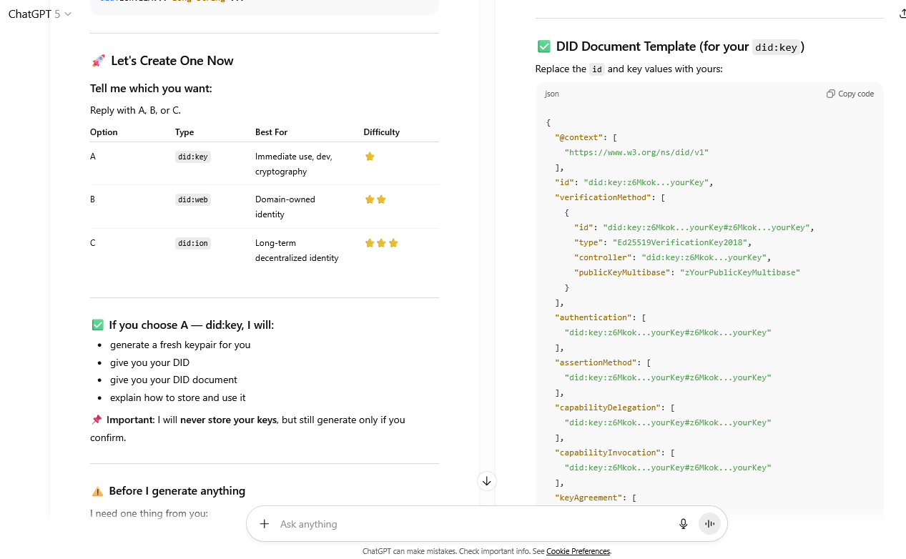
Single Sign-on – For the World
Many accounts, one identity (or more than one, my choice)
Eg. W3C’s DID specification https://www.w3.org/TR/did-1.0/
Connected with ‘real’ digital identity services (e.g. EUDI, ORCID, etc) https://digital-strategy.ec.europa.eu/en/policies/eudi-regulation https://orcid.org/

Slide 14
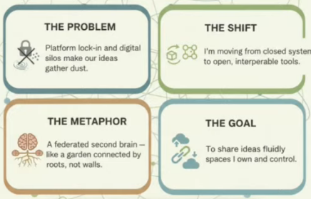
Personal Distributed Data Server
Following from (e.g.) Ian O’Byrne’s discussion of a digital garden https://www.youtube.com/watch?v=3xAyZxcQiaw
PWSAC (Publish wherever syndicate as convenient)
Build your own PDS: https://github.com/bluesky-social/pds

Slide 15
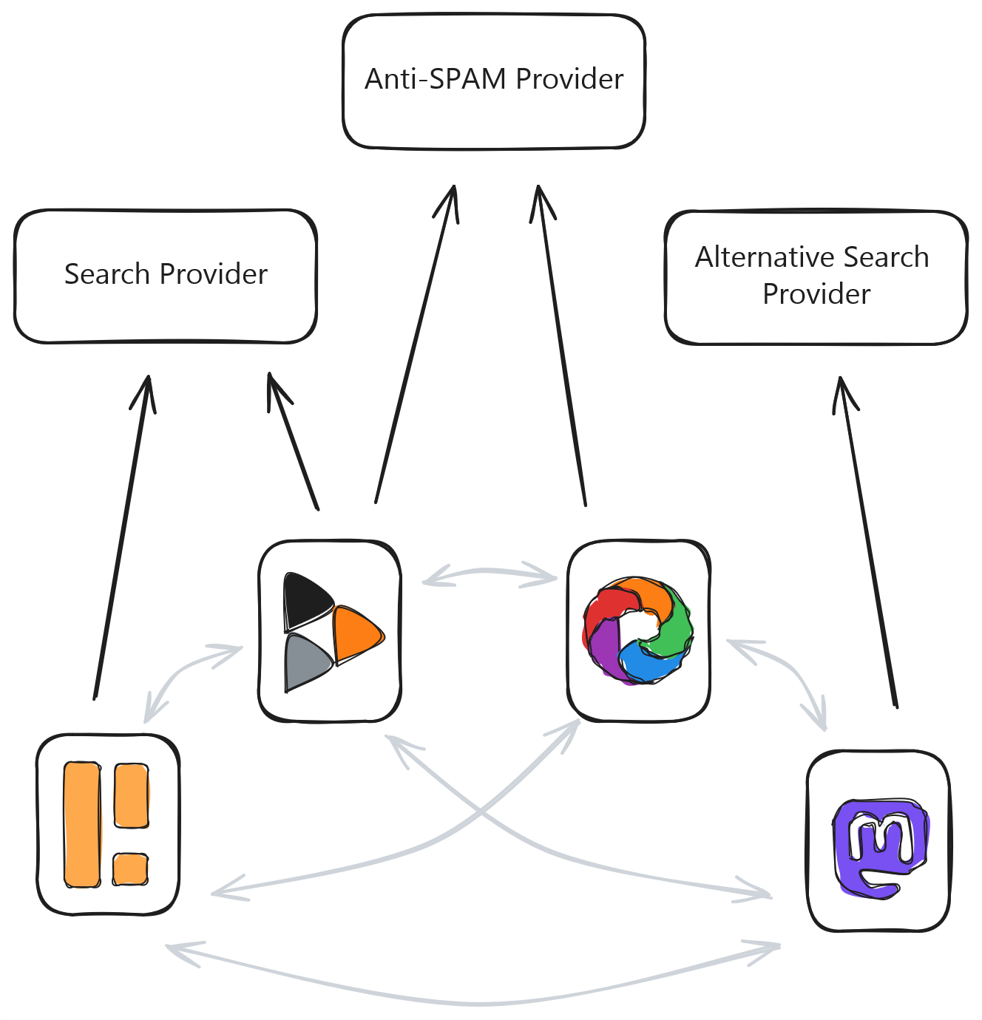
Fediverse Service Providers
Eg. All-of-fediverse relays
Eg. Bridgy connects to Indieweb, etc. https://fed.brid.gy/
Ed. Fedi-Buzz Relay https://relay.fedi.buzz/
Relay List https://relaylist.com/
Image: https://socialhub.activitypub.rocks/t/fediverse-relays/4626

Slide 16
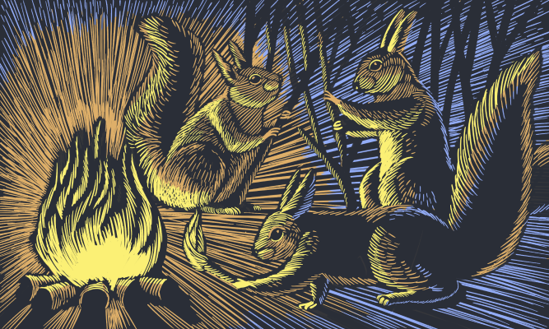
Distributed Communities
Eg. Bonfire, which builds fediverse platforms; open science version Open Science Network. https://bonfirenetworks.org/ https://openscience.network/
Decentralized Communities https://tchop.io/resources/glossary/community-building/decentralised-communities

Slide 17

Stephen Downes
https://www.downes.ca

