Slide 1


Personal Learning in the Age of AI
Stephen Downes
OTESSA 2026
June 9, 2026

Slide 2
Every technology we use represents a choice
Who makes that choice?
Could there ever be an opt-out?
Considering the harms…
  Data security
  Privacy and surveillance
  Stress of change
  Accessibility
Brenna Clarke Gray
https://drive.google.com/drive/folders/1y5oXw-3RcoHYf_R0dHqQrHRg1Ow5FghN
The logic of education is one which values knowledge as a public good, a commons, and a shared human inheritance - Bonnie Stewart - Beyond BigAI: Agency as Educational Practice

Slide 3
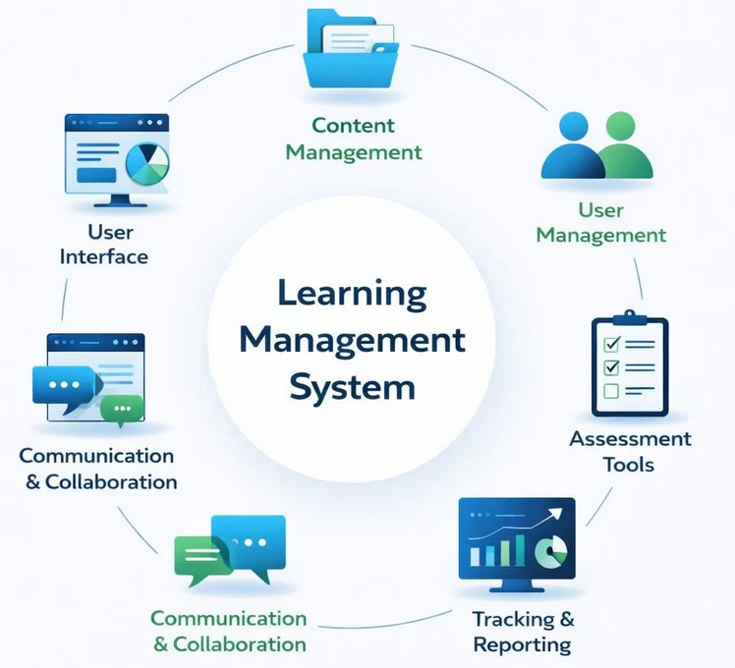
The problem with platforms
In the LMS era, the platform organized the learning experience.
Today, we’re just adding AI to the platform.
Learners do not define their own learning environment. It is defined for them by institutions, vendors, recommender systems, or AI defaults.
Image: LMSpedia https://lmspedia.org/lms-components-explained-core-features-architecture/

Slide 4
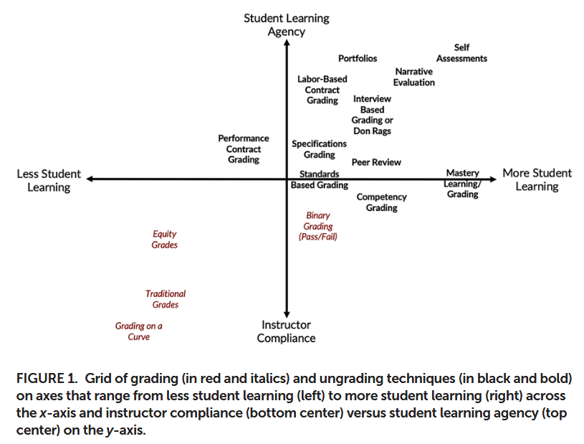
We have often make the wrong choices in education
The point of learning in an
asset frame is not to fill a hole in the student or assume that they have the wrong knowledge upon entry to higher education classrooms, but to enable students to share their knowledge openly and to build on that knowledge in ways that benefit the learning of student and the learning of the class
Clarissa Sorensen-Unruh https://www.lifescied.org/doi/pdf/10.1187/cbe.24-01-0031

Slide 5
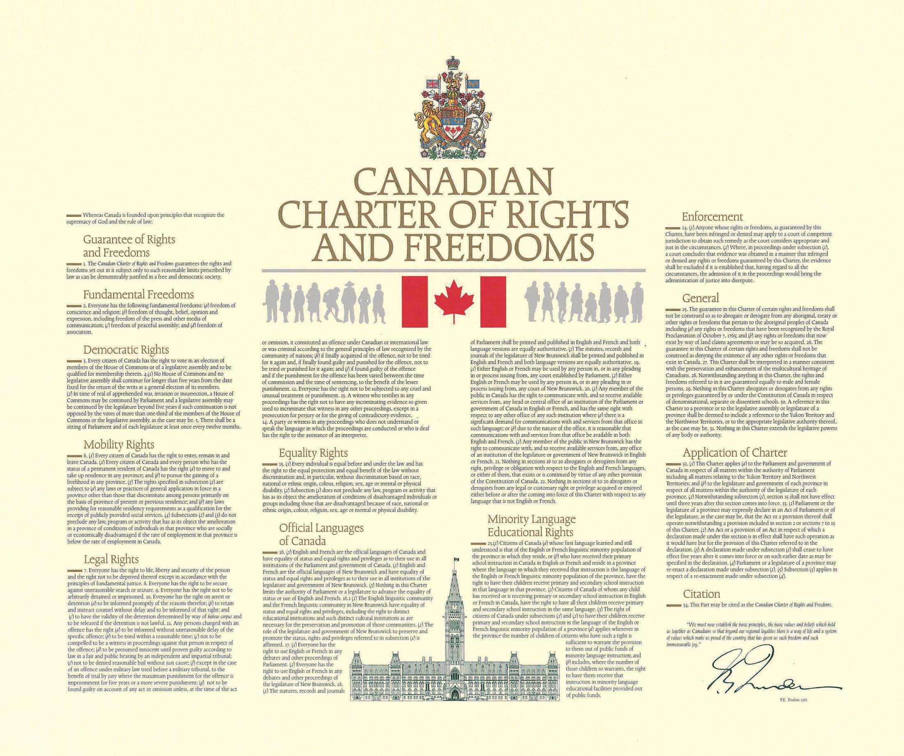
Digital Platform Charter of Rights
A declaration of fundamental rights and principles for ethical digital platforms, ensuring privacy, dignity, and fairness in online spaces.
https://respectfulplatforms.org/
Right to privacy
Freedom from surveillance
Safeguards against hate speech
Strong protections for vulnerable communities
Data portability and user agency
Transparency and accountability
Safety and well-being
Transparent cybersecurity posture
Fairness in algorithmic systems
Inclusive community and governance
Continuous improvement and evolution

Slide 6
Here’s what I want to say
A personal learning environment in the age of AI should be an architecture of agency.
It should be a learner-defined environment in which people choose and connect their sources, tools, identities, storage, publishing destinations, collaborators.
The role of AI is to help individuals and institutions overcome the barriers to personal learning that have led to disappointing technology choices in the past.

Slide 7
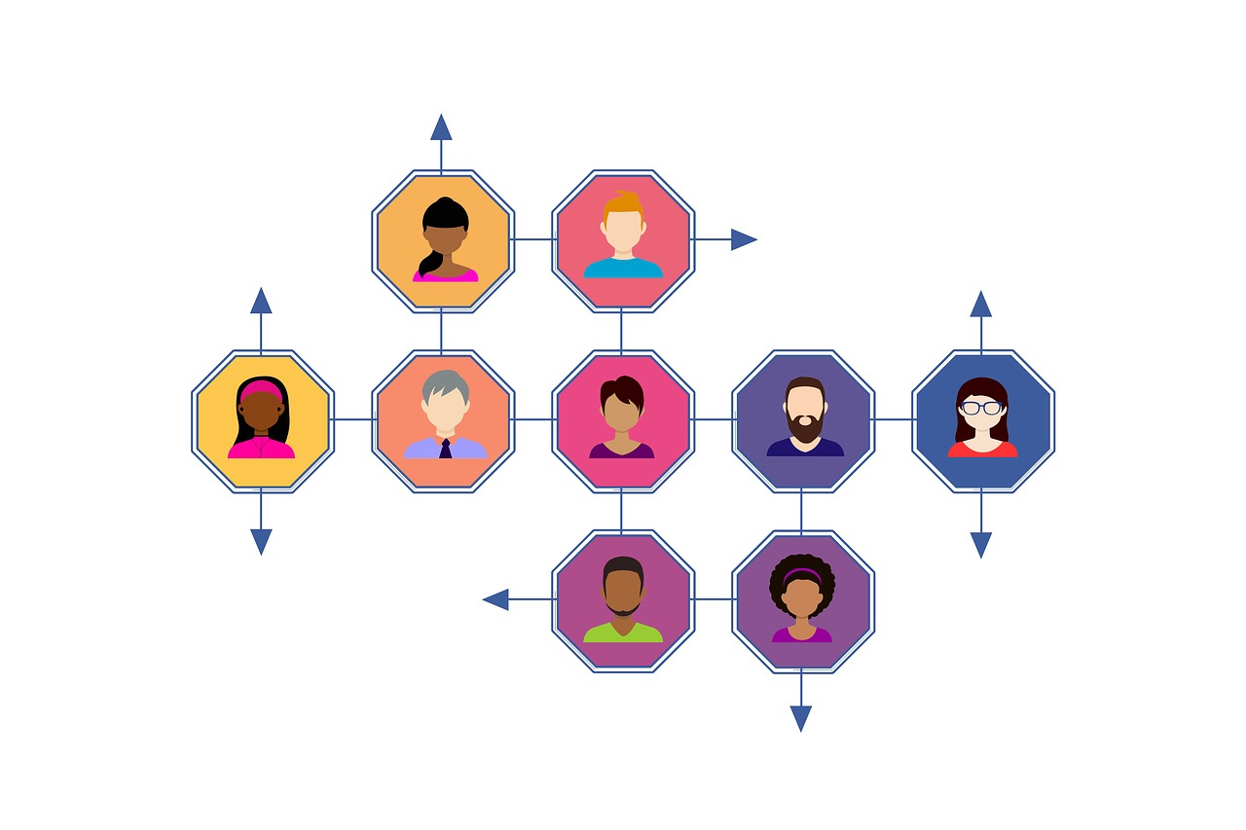
Personal Learning
Personalization | Personal Learning
The system adapts to the learner | The learner shapes the system
Vendor-defined pathways | Learner-defined architecture
Platform owns and controls the data | Learner owns and controls the data
AI recommends | AI is directed
Optimization | Agency
How to Help Students Succeed by Taking Ownership of Their Learning Online Through Personal Learning https://www.downes.ca/presentation/524
Image: Nexus https://nexus-education.com/blog-posts/developing-your-personal-learning-network-pln/#

Slide 8
An architecture of agency
Personal learning means the learner has meaningful control over:
Identity - Who am I across systems?
Sources - What do I read, watch, follow, or subscribe to?
Annotation - How do I respond while reading?
Memory / storage - Where are my notes, credentials, drafts, and records?
Composition - How do I synthesize, reflect, argue, and create?
AI services - Which models or agents do I use, and for what?
Publishing - Where does my work go?
Social feedback - Who can reply, annotate, remix, or build on it?
Governance - Who sets the rules, permissions, and defaults?
An architecture of agency doesn’t just define mechanisms of choice for each of these, it provides viable access to them through common interfaces

Slide 9
An architecture of agency
An architecture of agency defines the interfaces between the elements of a learning environment so people can select, replace, combine, or reject components.
It should allow different learners to build different environments based on their own needs, values, culture and commitments.
There’s a parallel with the open web here:
Open protocols
Interoperability
Permissionless innovation
User agency and portability
Decentralization
Center for Democracy and Technology https://cdt.org/insights/preserving-the-open-internet-through-interoperability/
Michael Nolan https://spectrum.ieee.org/doctorow-interoperability

Slide 10
No single platform, distributed architecture, open Source, personal data ownership
Me!
Distributed ID
Own my own Data
RSS Feeds
Social Media
Spaces
Search
Annotations
Chat
Etc.
Blogs -----> RSS Feeds
Social Media
Spaces
Search
Annotations
Chat
Etc.
Aggregate
Read
Write
Publish
ple
Indexing
Filtering
Translation
Combining
Etc.
Editors (text, HTML, Image, etc)
Chat Rooms
Collaborative Spaces
Templates

Slide 11
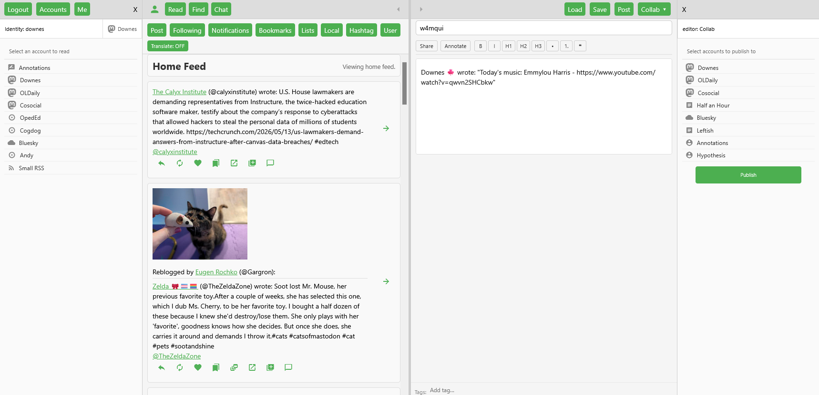
Clist: Building interfaces between these elements
https://clist.mooc.ca
See also Matthias Melcher: https://jellyboard.ca/boards/v8dpkjwr

Slide 12
The core design principles
Browser-based, not platform-based
no server-side logic, no backend to install
each user runs their own instance; no central platform, no shared data store
accounts, credentials, feed collections, and annotations all belong to the user - stored encrypted, private by default
can be deployed anywhere: a personal server, a CDN, or localhost
Radical decentralization
no mandatory central server - the app itself is a static bundle of HTML/CSS/JS
supporting services (credential storage, feed proxy, collaborative editing, peer discovery, annotations) are each independently deployable
users configure which instance of each service they use, or run their own
API calls to services are made directly from the browser; CList is never in the middle

Slide 13
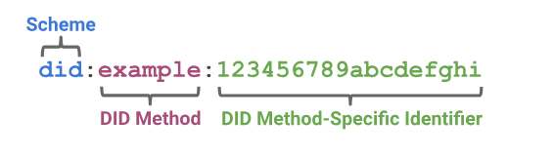
Decentralized identity
Credential store
all service credentials (tokens, passwords, API keys) are stored in a remote kvstore that holds only AES-GCM ciphertext
it never sees plaintext credentials - not even its own
DID
“In contrast to typical, federated identifiers, DIDs have been designed so that they may be decoupled from centralized registries, identity providers, and certificate authorities.”
Decentralized Identifiers (DIDs) v1.0 https://www.w3.org/TR/did-1.0/

Slide 14
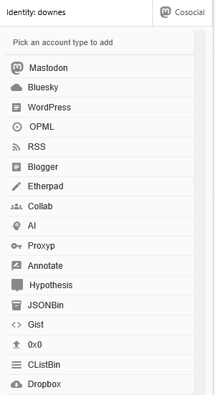

Accounts and credentials
Account schemas
Different forms of authentication are supported (key, OAuth, more…)
Every service that needs credentials registers a schema: field definitions, permissions, form behavior
Service actions are defined using a set of handlers (one handler for each interface area - feed functions, status actions, publish…)
Authentication: https://www.okta.com/identity-101/authentication-protocols/
OAuth 2.0 https://oauth.net/2/

Slide 15


Account types
Permissions flags (substring, composable):
r read
w write
e editor
t translate
g AI
z summarize
s RSS relay
b bin/publish
G
T
W
R
E
S
B
Z
This is probably an incomplete list. Account types are defined by their interfaces and handlers. No specific services are required (not even identity services). Any service that can provide the interface can be a part of Clist.

Slide 16
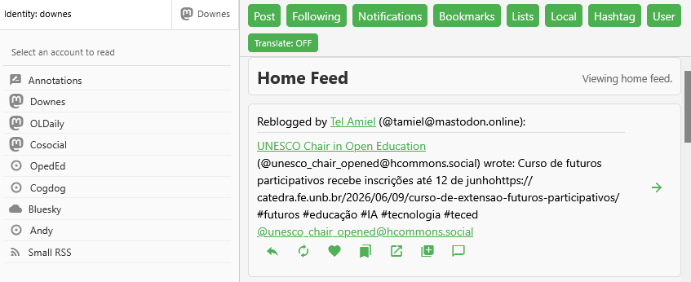
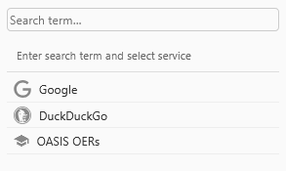
Readers
Feed definitions
Feed Sources
CList Actions
Status Actions
Send to editor
Reply Bookmark Collect
Like Expand Chat
Boost

Slide 17
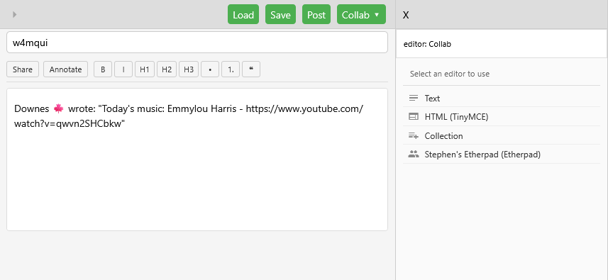
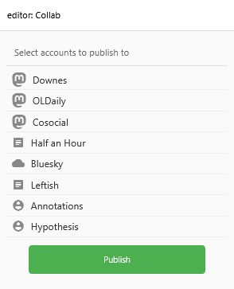
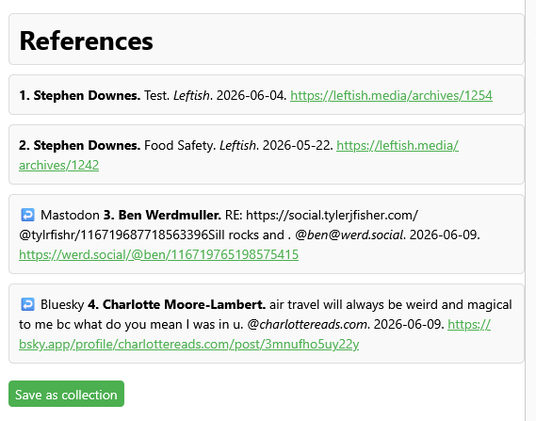
Editors
Select Editor

Slide 18
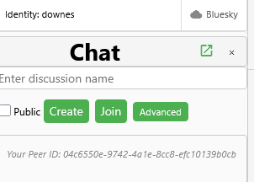
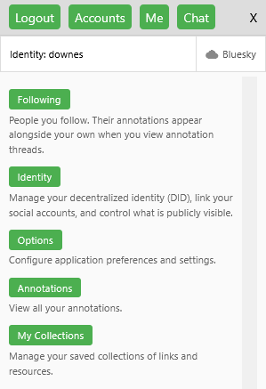
Interaction and Collaboration
Following
in CList, people follow other people by DID
Who you follow is your private information
Chat
Peer-to-peer chat, no central chat server
Invite to chat, creates opportunities to follow
Annotations
- Attached to any type of content
No central annotations server
Viewed by followers
Collections
Are a document type
Can be published as RSS, OPML, JSON
Can be shared and merged
Collaborative Editing
Is an editor type
Invite in from chat or via URL

Slide 19
Taking privacy seriously
CList does not aggregate or transmit user activity between services - API calls go directly from browser to platform
What is private: passwords/API keys (never leave the browser in plaintext), reading history, cross-service correlations, social graph (encrypted in kvstore)
What is not private: annotation batch checks reveal reading activity to the annotation server; RSS polling reveals IP and timing to feed hosts; social platform API calls are visible to those platforms
Follow graph is private to the follower - by design, CList never publishes "who follows you" because that would require centralizing follower data
Annotation visibility: public or private; no followers tier (would require server-side social graph queries, violating decentralization)
But you can host your own
Can’t be commodified or used for advertising

Slide 20
Key services
Discussions
Key services
kvstore (credentials)
localRSS (RSS aggregator)
opml2json (feed parsing)
annotations (annotations)
collab (Hocuspocus collab editor)
pastebin - plain file server
discussions (P2P discovery)
proxyp (cross-domain proxy)
care (publishing on IPFS)
Clist browser extension (annotate & collect)
WordPress extension (add DID to RSS feed)
Collab Editor
Identity
CList
File Server
Publishing
RSS / OPML
Annotate

Slide 21
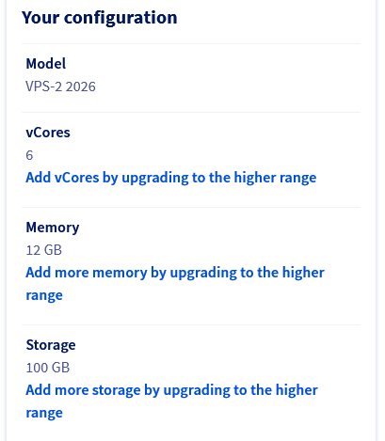
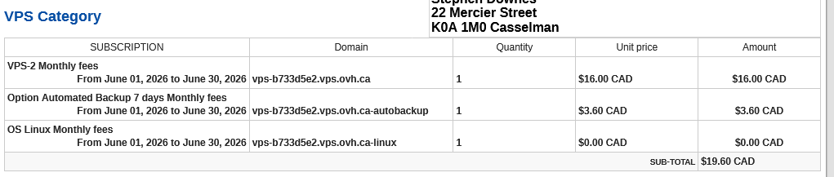
Deployment
Static files served by Caddy — no server-side processing
Supporting services run in Docker containers on the same VPS, each on the web network, reverse-proxied by Caddy
CORS handled entirely in Caddy (not in Flask), to avoid OPTIONS header injection failures with flask-cors
Desktop launcher: PKCE OAuth flow bridged via callback.html?local_port=PORT to handle HTTP-only localhost

Slide 22
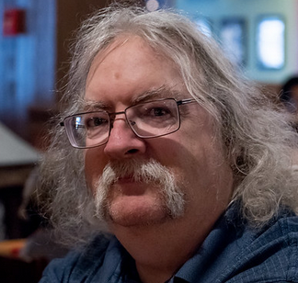
Stephen Downes
https://www.downes.ca

