Slide 1

Technology, Diversity and Human Connection
Stephen Downes
V UNEMI English Convention
Milagro, Ecuador
June 19, 2026

Slide 2

Connectivism

Slide 3
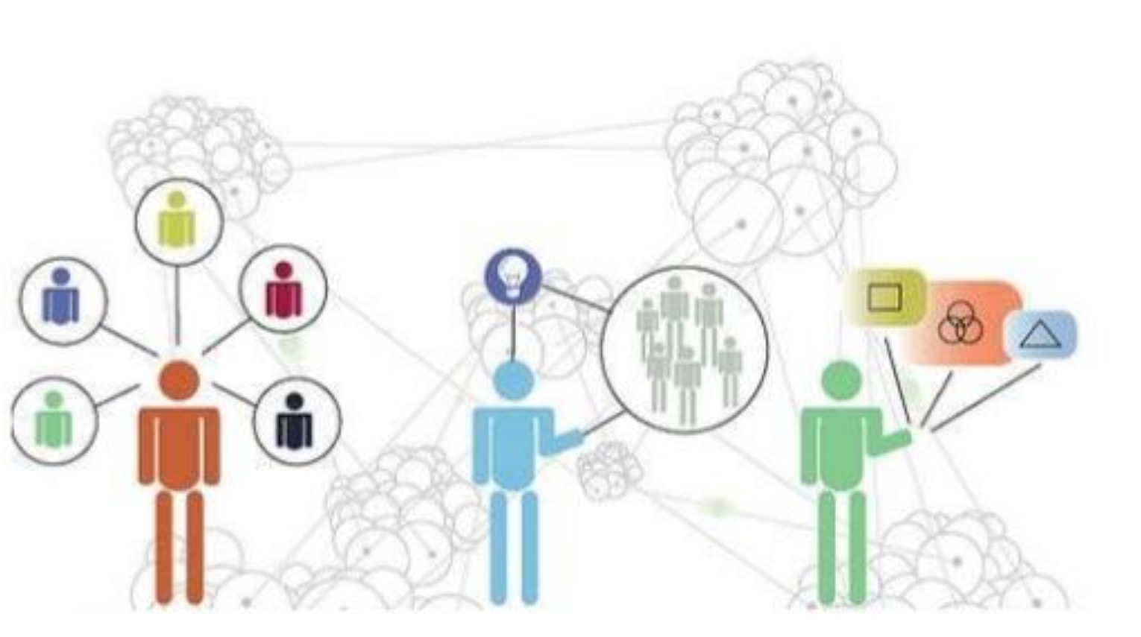
Connectivism
Knowledge is distributed across a network of connections
Learning consists of the ability to construct and traverse those networks
https://wwmit.blogspot.com/2018/07/connectivism-new-learning-theory.html
https://uark.pressbooks.pub/edtech/chapter/connectivism-and-connective-knowledge-2/ ‘What Connectivism Is’

Slide 4
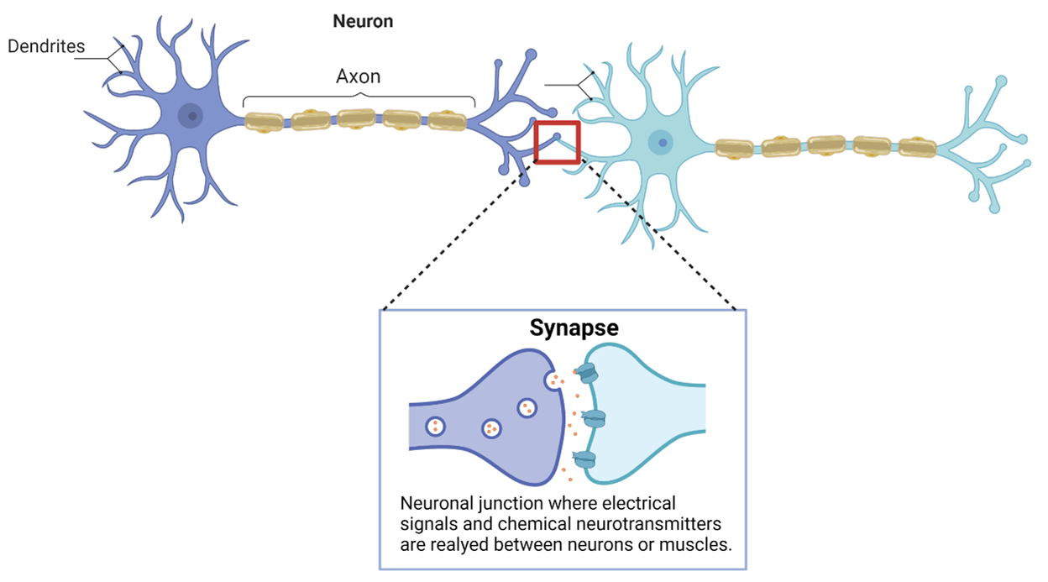
Knowledge
Is literally the set of connections formed by actions and experience
The properties and constraints of linguistic structures are not the properties and constraints of connectivism or connectivist knowledge.
https://uark.pressbooks.pub/edtech/chapter/connectivism-and-connective-knowledge-2/ ‘What Connectivism Is’

Slide 5

Knowledge
Is recognition
It is the activation of patterns of connectivity in a network created from previous experience
Distributed representation is a product of… the neurosciences and in connectionist work on recognition tasks
Churchland and Sejnowski http://books.google.ca/books/about/The_Computational_Brain.html?id=wVll6u0tzXoC&redir_esc=y

Slide 6

Knowledge
Is emergent
That is, it is organization of the connected entities, not the nature or contents of the entities
It is not inherent in the system producing it, but depends entirely on the perceiver being able to recognize it.
https://uark.pressbooks.pub/edtech/chapter/connectivism-and-connective-knowledge-2/ ‘Theoretical Synergies’

Slide 7
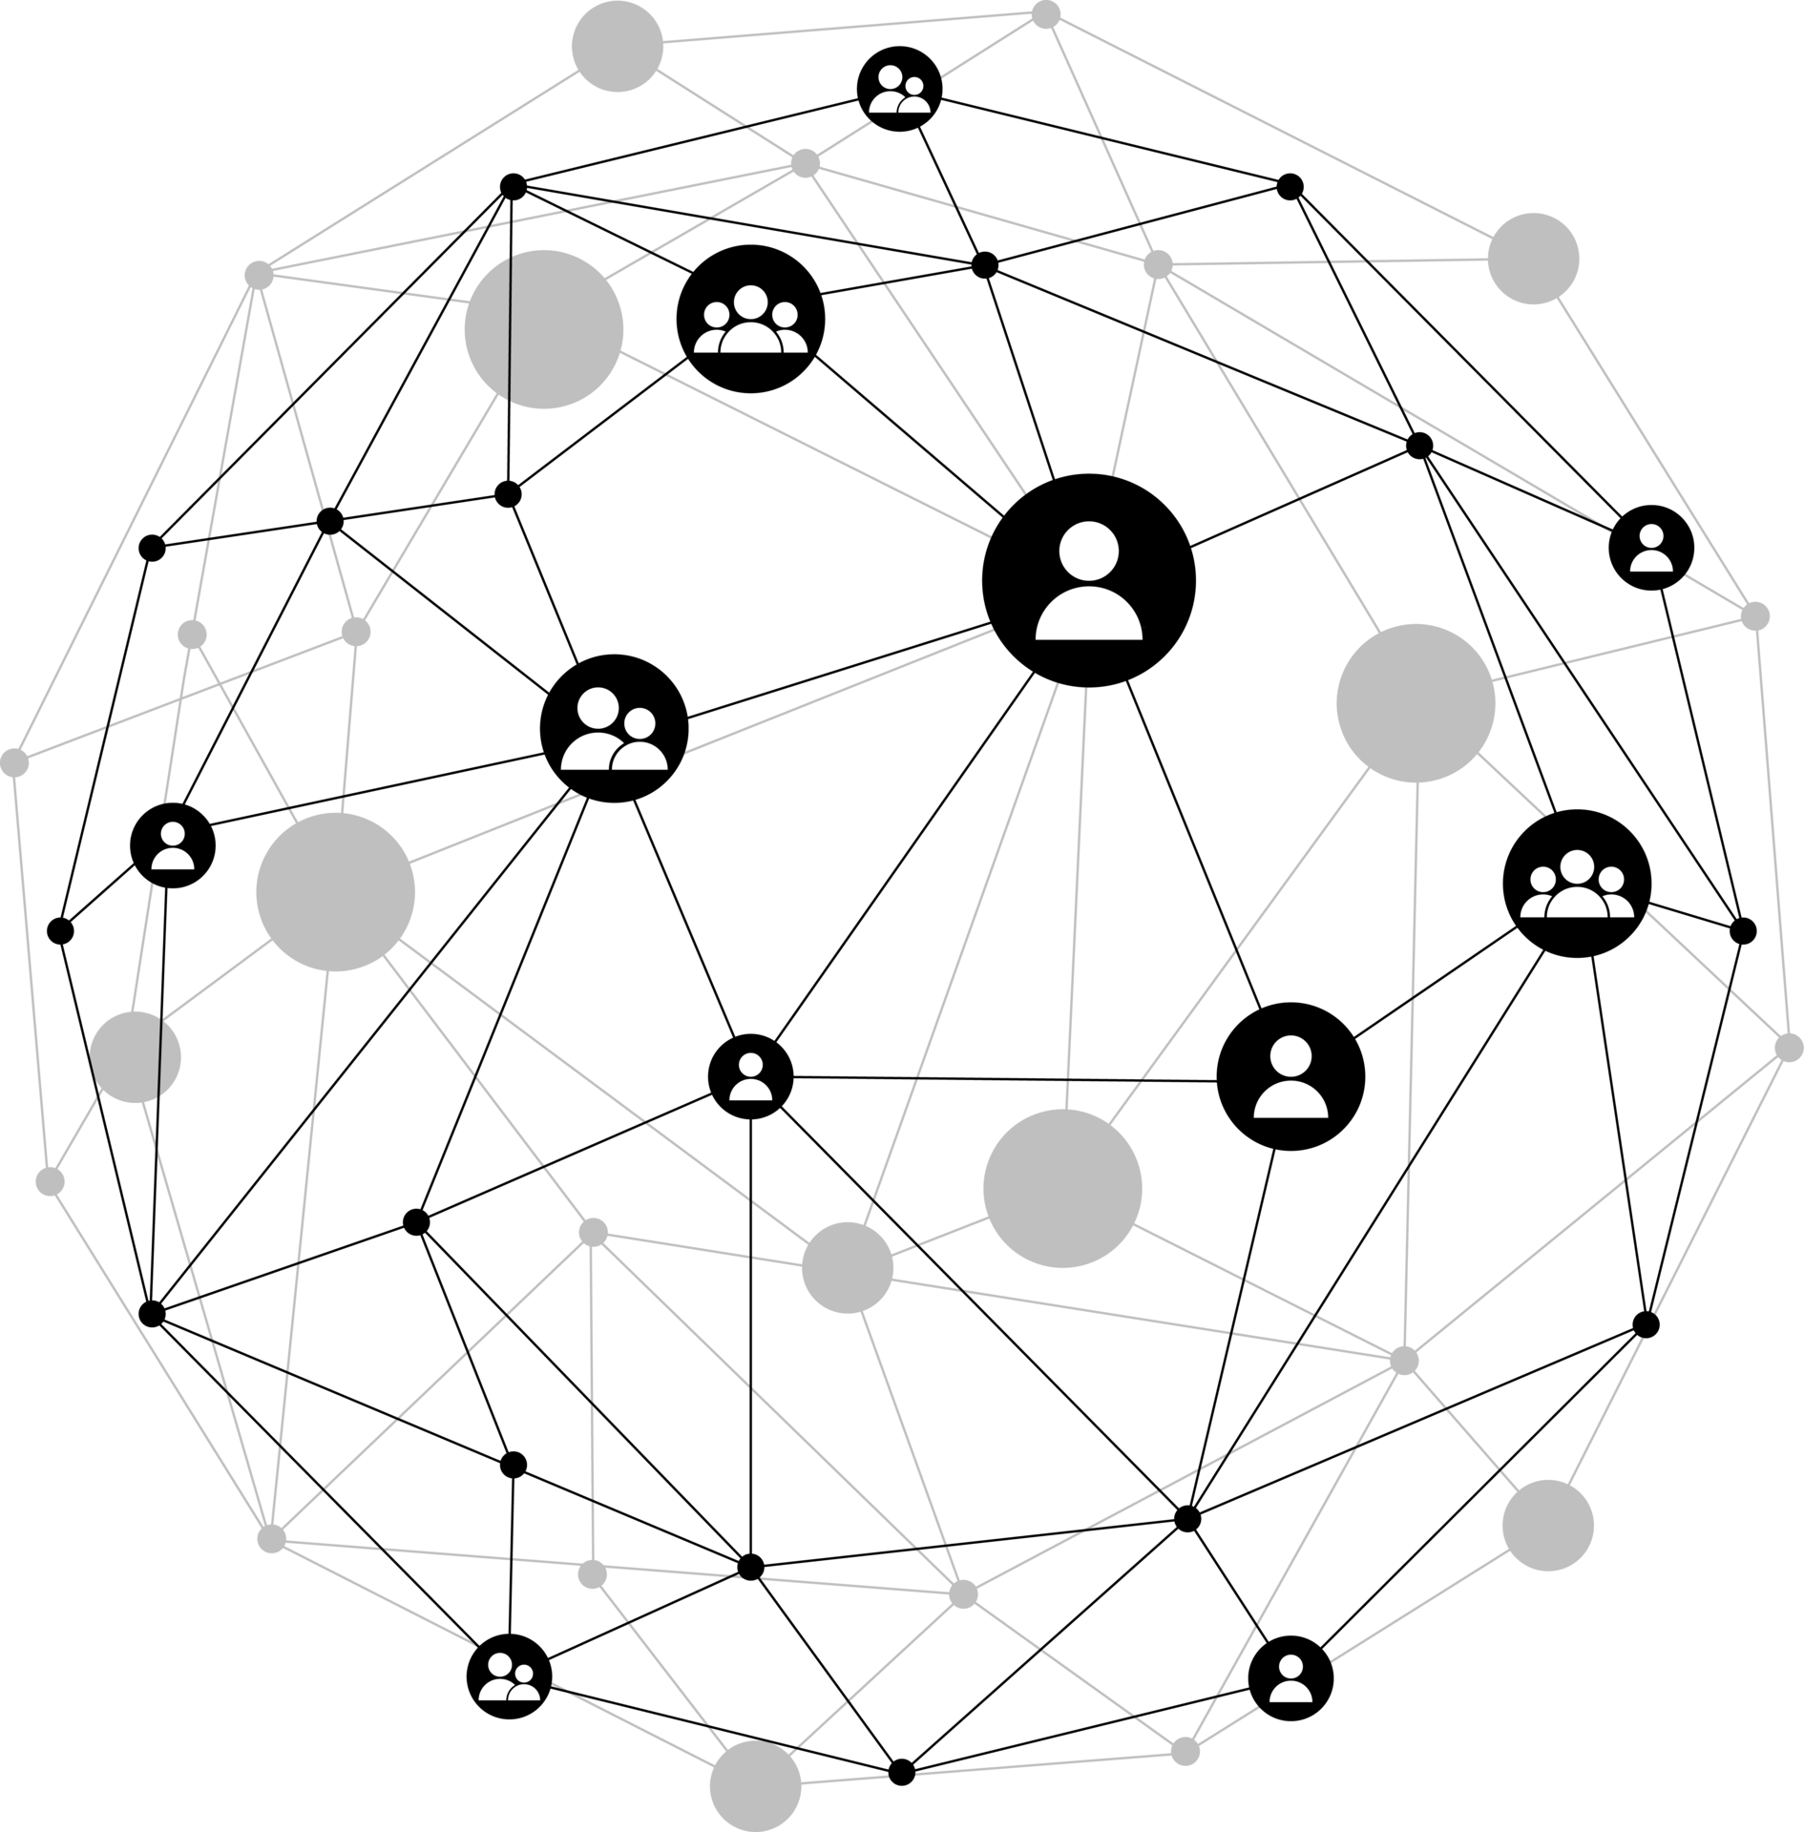
Connectivity
Two entities are connected if and only if a change of state in one entity can cause a change of state in the second entity
Churchland and Sejnowski http://books.google.ca/books/about/The_Computational_Brain.html?id=wVll6u0tzXoC&redir_esc=y

Slide 8
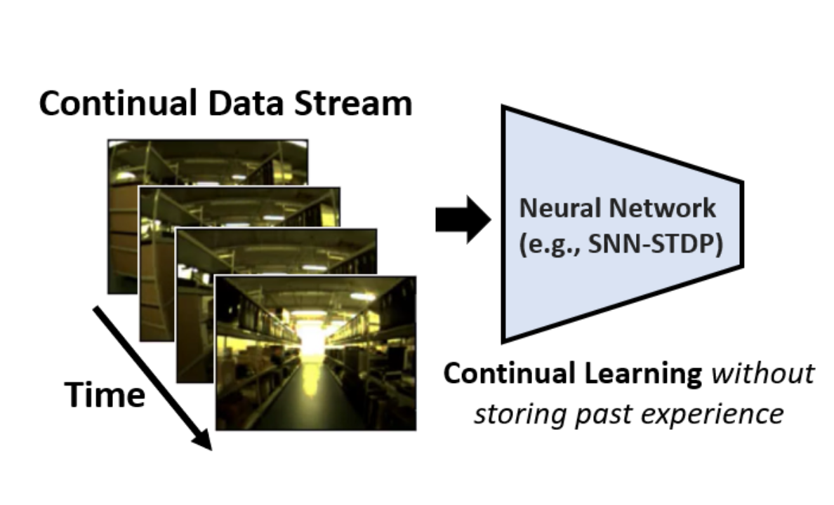
Learning
Is the creation of patterns of connectivity in a network created from previous experience
Learning theories are specifically generalized descriptions of how networks of entities become connected
https://arxiv.org/pdf/2407.17305 p. 15
https://uark.pressbooks.pub/edtech/chapter/connectivism-and-connective-knowledge-2/ ‘What Connectivism Is’

Slide 9
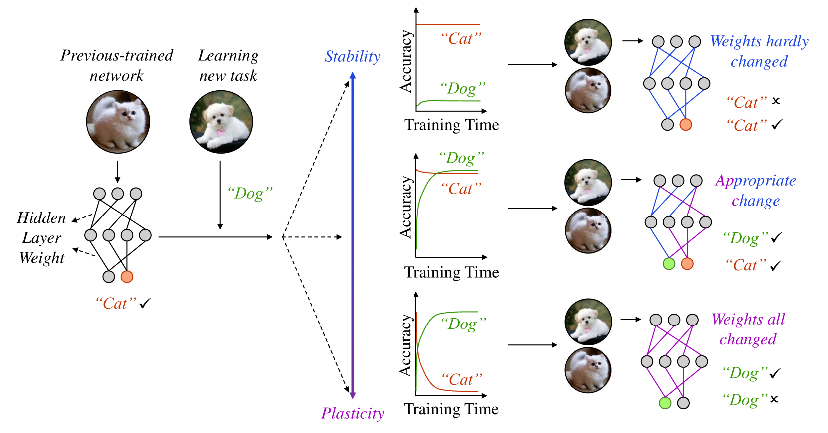
Learning Theories
Can describe the conditions that are supportive of network connectivity
Can describe the mechanisms that result in the creation of network connectivity
Can describe the kinds of network connectivity

Slide 10

Technology

Slide 11

Technology
These days, we think of technology as ‘digital technology’
But it’s not just a collection of tools, platforms and gadgets
It can be understood as the “orchestration of phenomena for some purpose”
https://openpraxis.org/articles/10.55982/openpraxis.18.2.1117

Slide 12

Teleology
A philosophical concept that explains causes in terms of ends, purposes, or goals.
Either things have inherent purposes, or they are created for the achievement of some externally defined purpose
https://en.wikipedia.org/wiki/Teleology

Slide 13
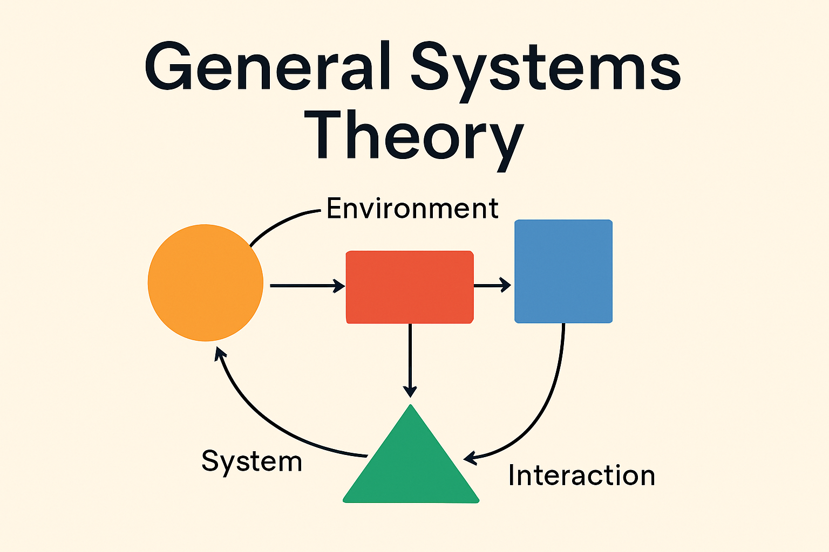
Systems
A system is a network with a purpose
Stafford Beer: “the purpose of a system is what It does” (POSIWID)
I would add: “… what is does for us”
Beer, S. (1985). Diagnosing the System for Organizations. Chichester: John Wiley & Sons.

Slide 14
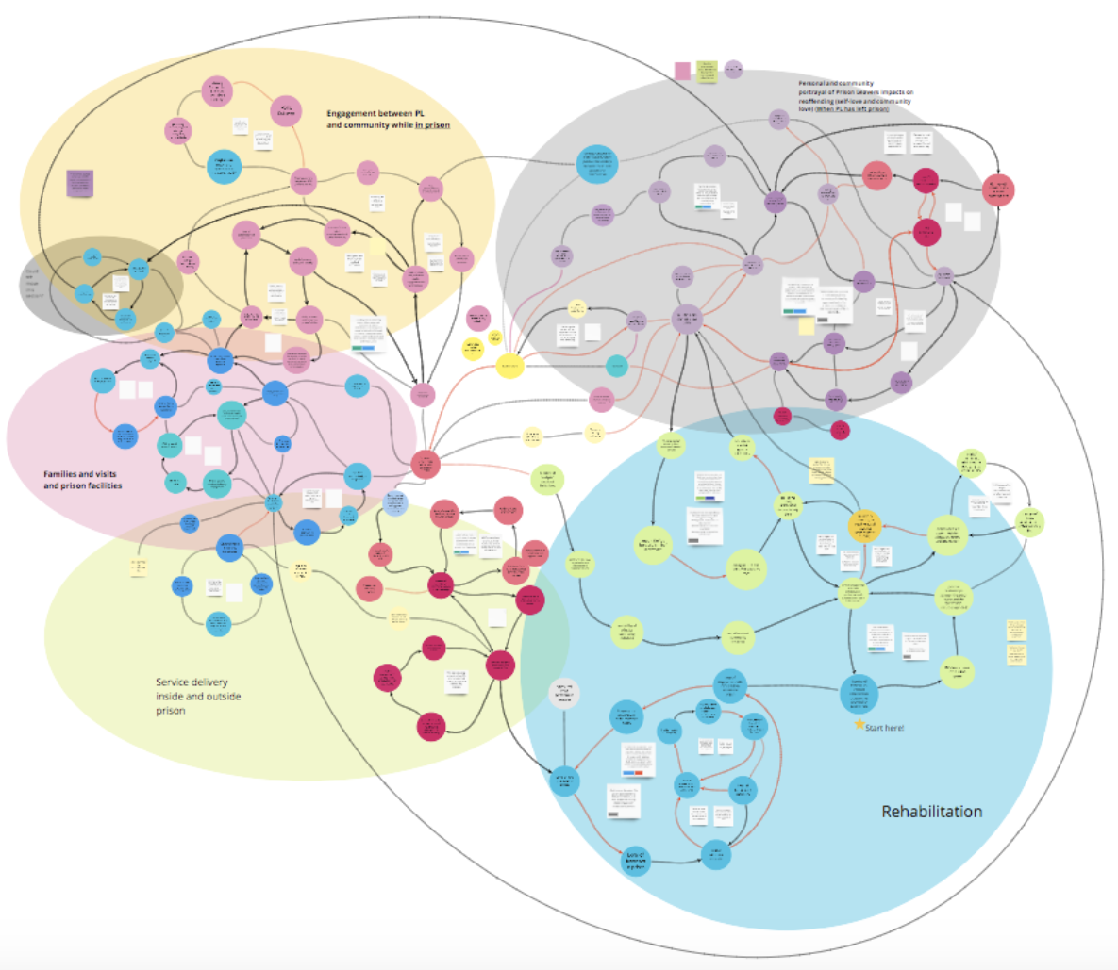
Learning Technology
What is the purpose of learning technology? Three answers:
  To transmit knowledge
  To construct knowledge
  To grow knowledge

Slide 15
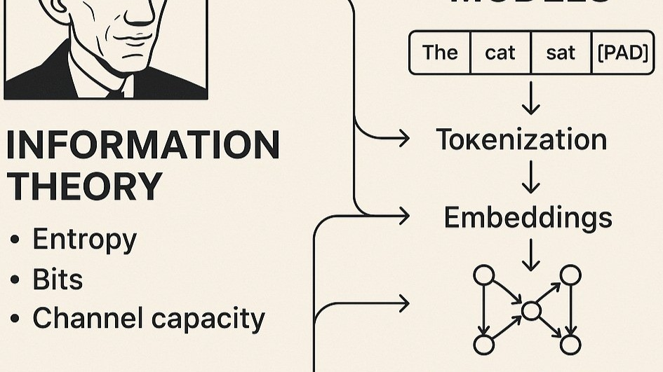
Transmission
Based in cognitivist and information-theoretic approaches
Values fidelity of information transmission
Error: depicting knowledge as a physical symbol system
Michael G. Moore, Theory of Transactional Distance https://www.researchgate.net/publication/262488021_The_Theory_of_Transactional_Distance

Slide 16
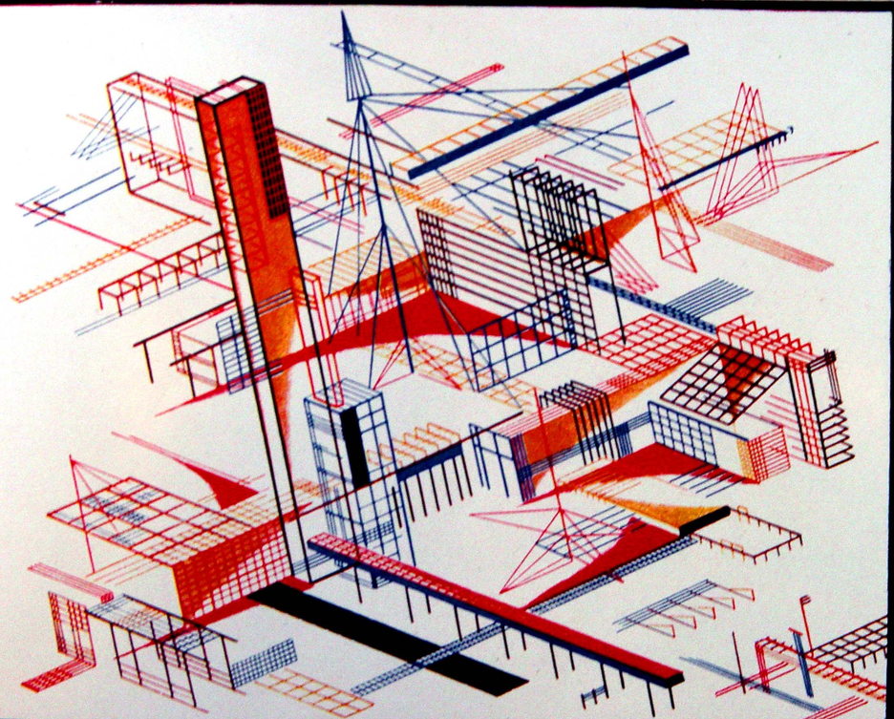
Construction
Understands that knowledge is not transmitted but is created anew in each individual learner
Has origins in philosophical and scientific constructivism
Error: conflating public knowledge and personal knowledge
https://www.simplypsychology.org/constructivism.html

Slide 17
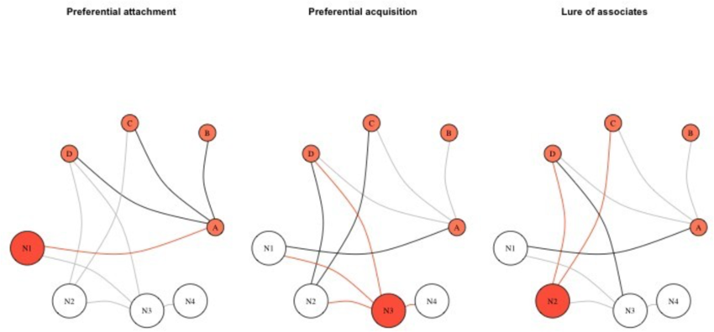
Growth
Knowledge develops naturally in each individual learner
It is an adaptive response to experience
The purpose of knowledge is separated from the origin of knowledge
https://www.researchgate.net/figure/Network-visualizations-of-network-growth-models-described-in-the-text-Smaller-nodes-are_fig2_359191824

Slide 18

Diversity

Slide 19

Diversity
Difference, rather than sameness
References practices that create equitable and supportive learning environments that “respect, value, and respond to the differences among learners,” regardless of background, identity, or ability.
UNESCO https://www.unesco.org/en/query-list/d/diversity-and-inclusion-education

Slide 20
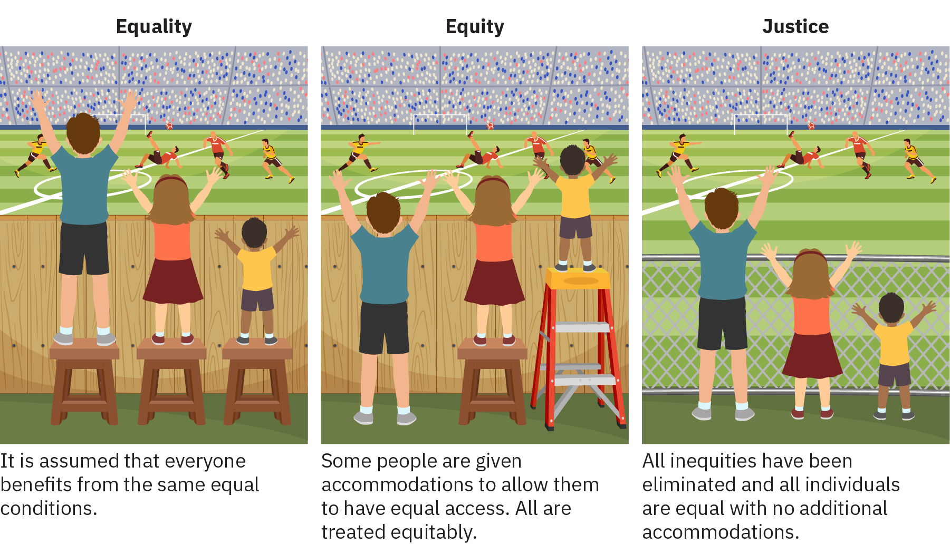
Equity, Inclusion
All, not some
Supporting diversity by promoting more equitable and inclusive education systems.
OECD: https://www.oecd.org/en/publications/equity-and-inclusion-in-education_e9072e21-en/full-report.html

Slide 21
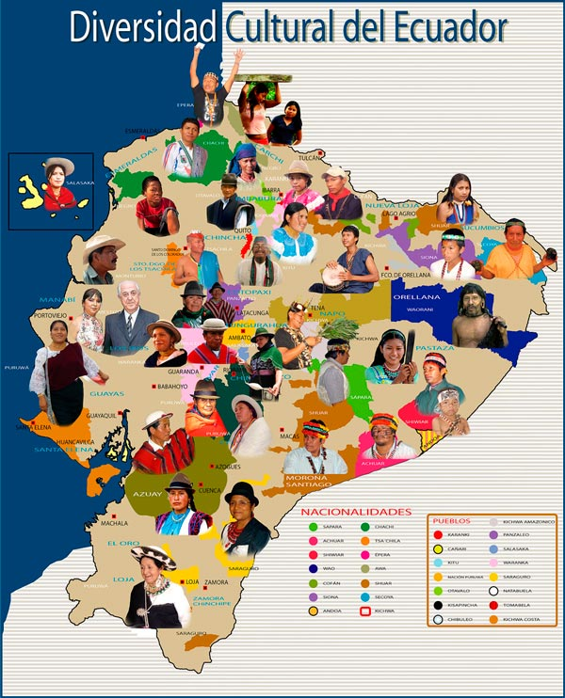
Ecuadorian Context
Multicultural, multinational, inclusive
A vision aligned with the country’s geographic, cultural, and linguistic diversity and with the rights of communities, peoples, and nationalities.
https://www.acnur.org/fileadmin/Documentos/BDL/2008/6716.pdf Art. 358, 377
https://ecuadorweb.net/la-diversidad-cultural-del-ecuador-que-es-definicion-y-ejemplos/

Slide 22

Objectives – Individual and Ethical
Human Rights – “This approach centers on the human being, both in their individual and social dimensions. Education is a right that enables the development of other rights to achieve a dignified life.”
https://www.gob.ec/sites/default/files/regulations/2025-02/codificado_de_la_ley_org%C3%A1nica_de_educaci%C3%B3n_intercultural.pdf p.8

Slide 23
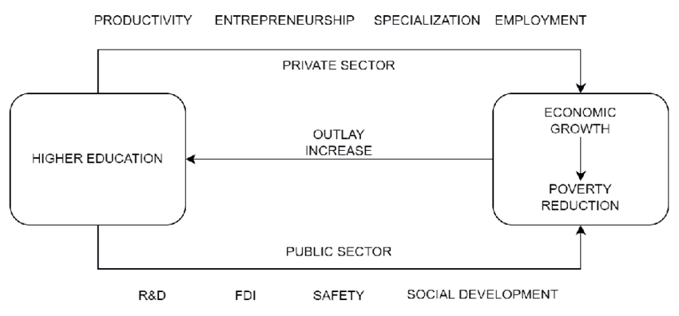
Objectives – Social & Economic
The enhancement of the country's productive capacities
Training individuals to launch their own individual or collective productive initiatives
Strengthening of an entrepreneurial culture.
https://www.gob.ec/sites/default/files/regulations/2025-02/codificado_de_la_ley_org%C3%A1nica_de_educaci%C3%B3n_intercultural.pdf p. 11
Image: https://www.researchgate.net/publication/369639173_On_the_effectiveness_of_remuneration_of_public_universities'_lecturers_in_Poland

Slide 24

But… Why?
The need for diversity does not follow from the reasons we tend to support diversity
As a result, education as a field is prolific with appeals to sameness
https://www.gob.ec/sites/default/files/regulations/2025-02/codificado_de_la_ley_org%C3%A1nica_de_educaci%C3%B3n_intercultural.pdf p. 11

Slide 25
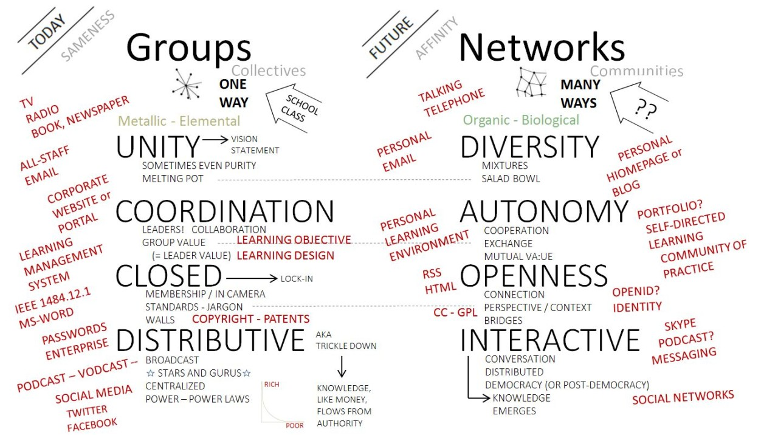
The Semantic Condition
Autonomy, diversity, openness, interactivity
These describe the conditions that are supportive of network connectivity
Without diversity, connections do not grow and change
https://www.downes.ca/presentation/477

Slide 26

Varieties of Diversity
Diversity is more than just intersectionality
Each person has their own unique experiences, and hence, knowledge
Diversity includes purpose and goals, learning preferences, technology options, more…
https://mastodon.social/@cpi/116768876643811670

Slide 27

Building Diversity: Be Yourself
Cultivating diversity of experience is a key to personal learning
This engages and requires the other conditions of autonomy and openness
And it involves understanding that social knowledge emerges through interaction from diverse perspectives
https://www.powerofpositivity.com/be-yourself-reasons/

Slide 28

Human Connection

Slide 29
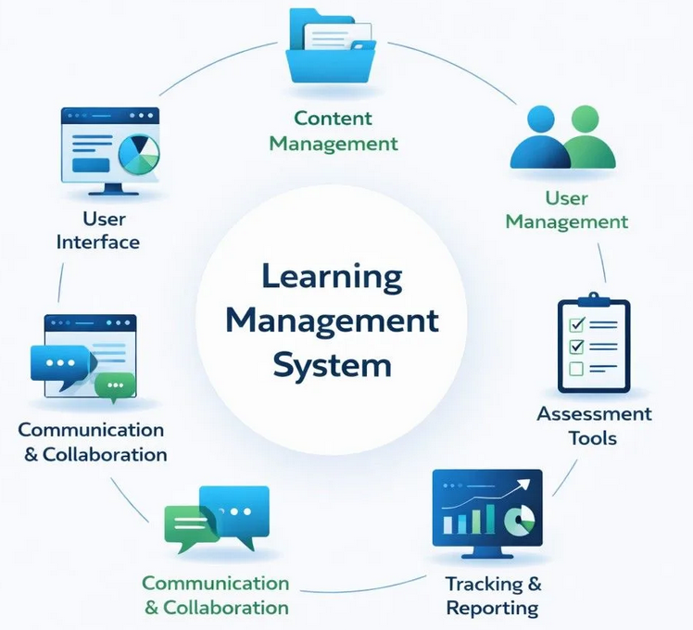
Platforms
In the LMS era, the platform organized the learning experience.
Today, we’re just adding AI to the platform.
Learners do not define their own learning environment. It is defined for them by institutions, vendors, recommender systems, or AI defaults.

Slide 30
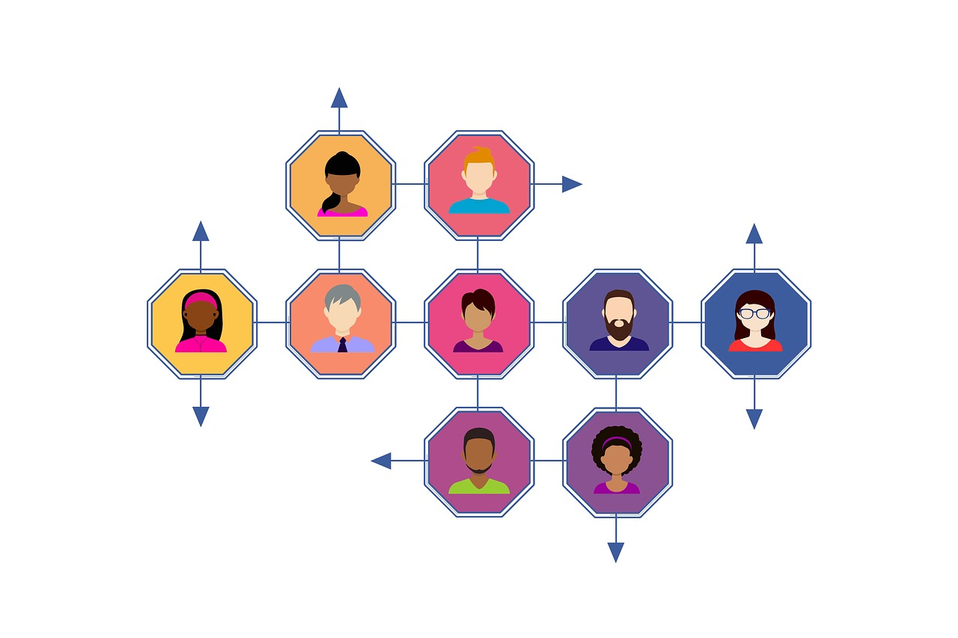
Personalization
The system adapts to the learner
Vendor-defined pathways
Platform owns and controls the data
AI recommends
Optimization
→ an Instructivist approach

Slide 31
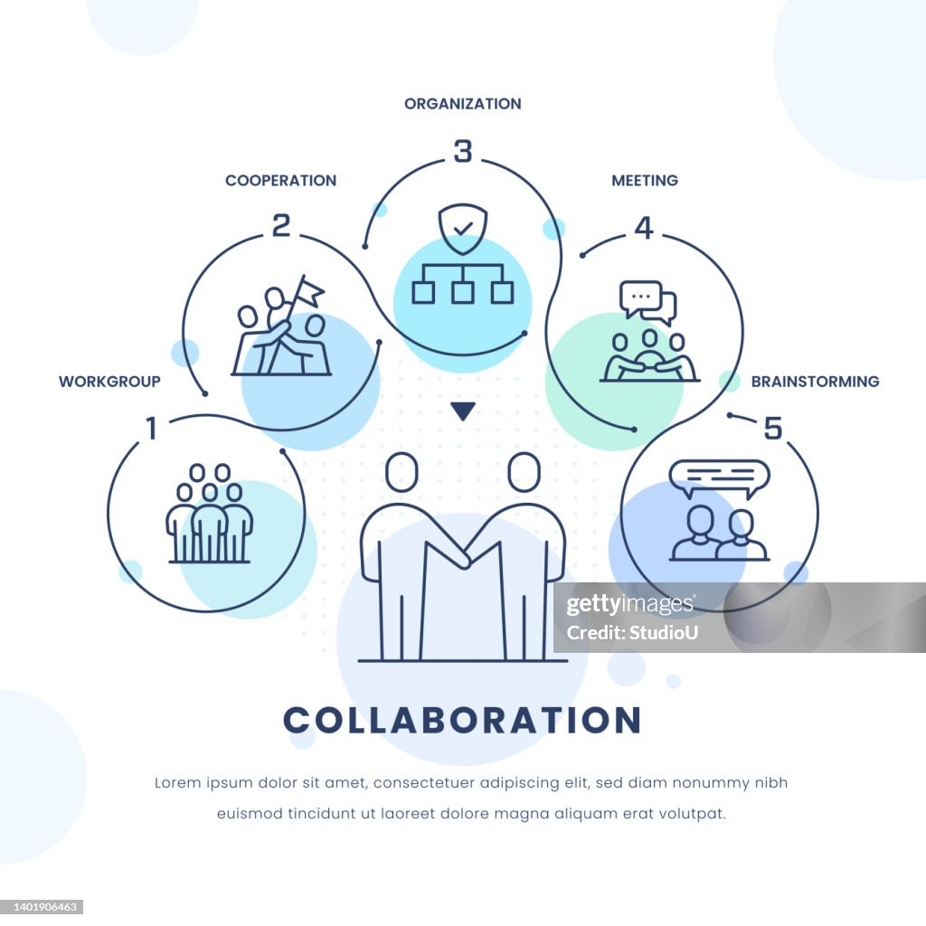
Collaboration
The system creates communities
Socially-defined pathways
Platform owns and controls the data
AI participates as collaborator
Process
a Constructivist approach
both are based on sameness

Slide 32
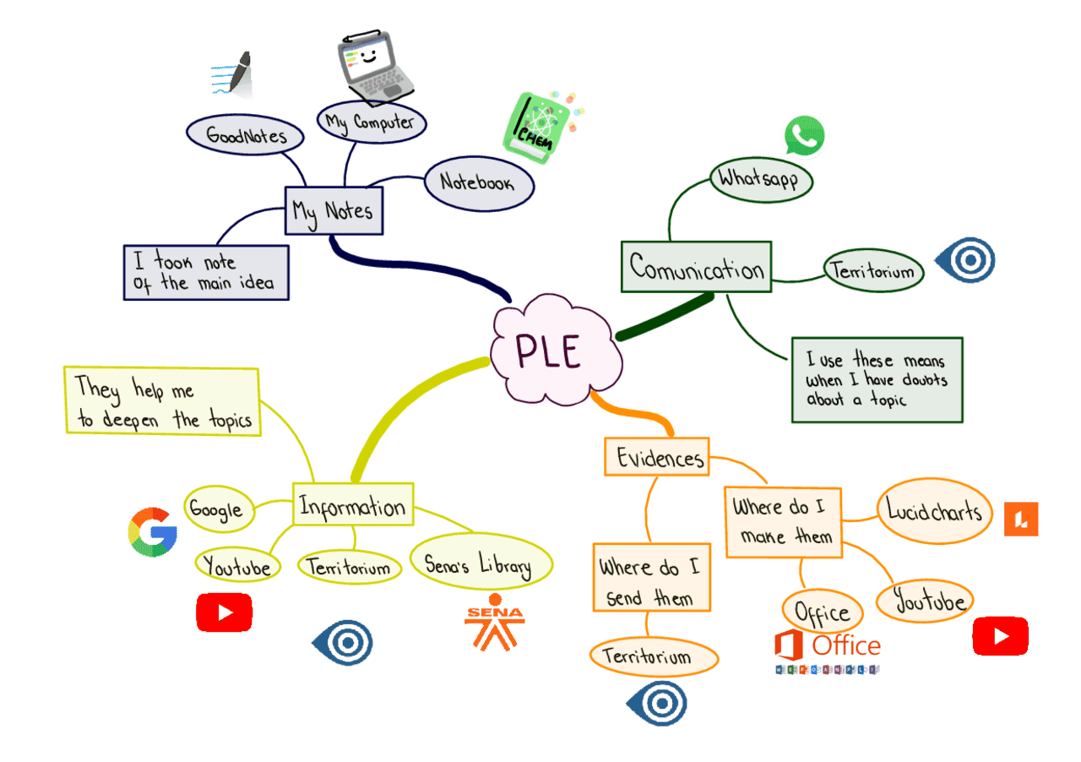
Personal Learning
The learner shapes the system
Learner-defined architecture
Learner owns and controls the data
AI and technology are directed
Agency
a Connectivist approach
based on diversity, autonomy
https://adsovirtual2455282.blogspot.com/2022/12/mapa-mental-sobre-su-personal-learning.html

Slide 33
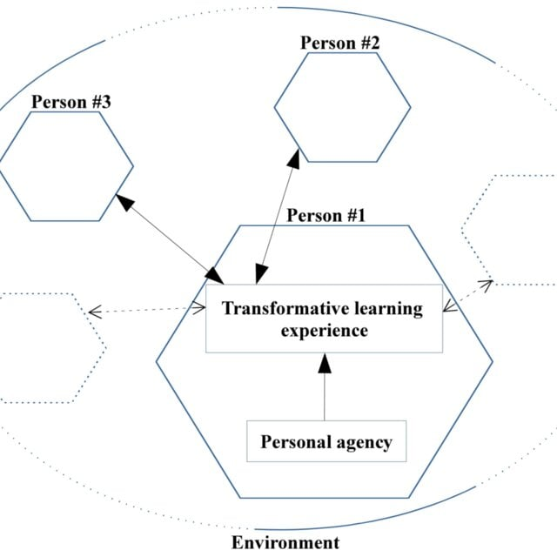
Agency
Technology should be an architecture of agency
People choose and connect their sources, tools, identities, storage, publishing destinations, collaborators
It helps them overcome the barriers, promotes inclusion, and encourages diversity
https://www.researchgate.net/publication/338757819_Transformative_Music_Learning_Experiences_A_Chinese_Immigrant_in_Northeastern_Brazil_and_his_Love_for_Musica_Sertaneja

Slide 34
Architecture
An architecture of agency defines the interfaces between the elements of a learning environment so people can select, replace, combine, or reject components.
It should allow different learners to build different environments based on their own needs, values, culture and commitments.
https://www.researchgate.net/publication/338757819_Transformative_Music_Learning_Experiences_A_Chinese_Immigrant_in_Northeastern_Brazil_and_his_Love_for_Musica_Sertaneja

Slide 35

Stephen Downes
https://www.downes.ca

